Slide 1

May the data be Visual!
The Bidiu Team

Slide 2
Awesome things to see in next 5min
When: When do people driving drunk?
Where: do people from different parts drunk driving differently?
Who: What kind of people drink?
Fun (basically sad) Facts

Slide 3
When

Slide 4
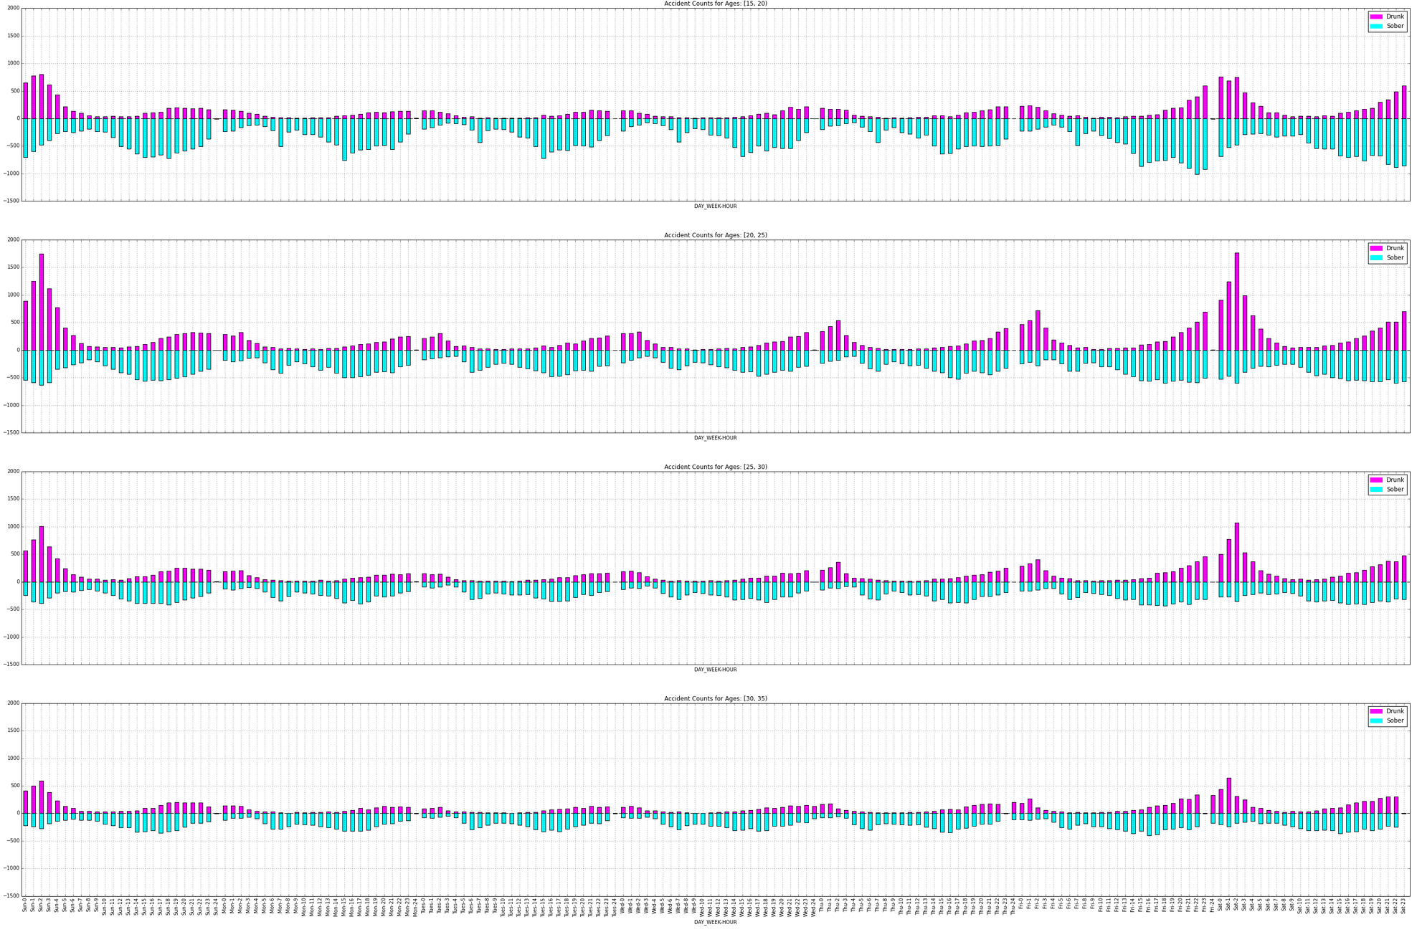
A Timetable
15-20
20-25
25-30
30-35

Slide 5
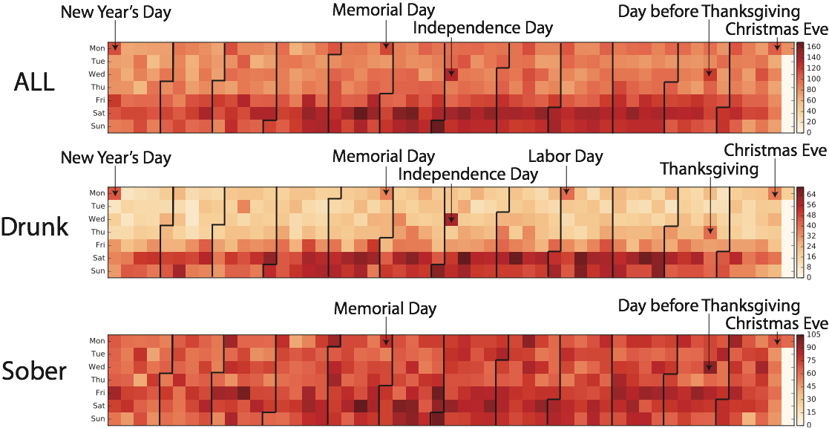
Accident Calendar 2007
Jan.1 is Mon.

Slide 6
Where

Slide 7
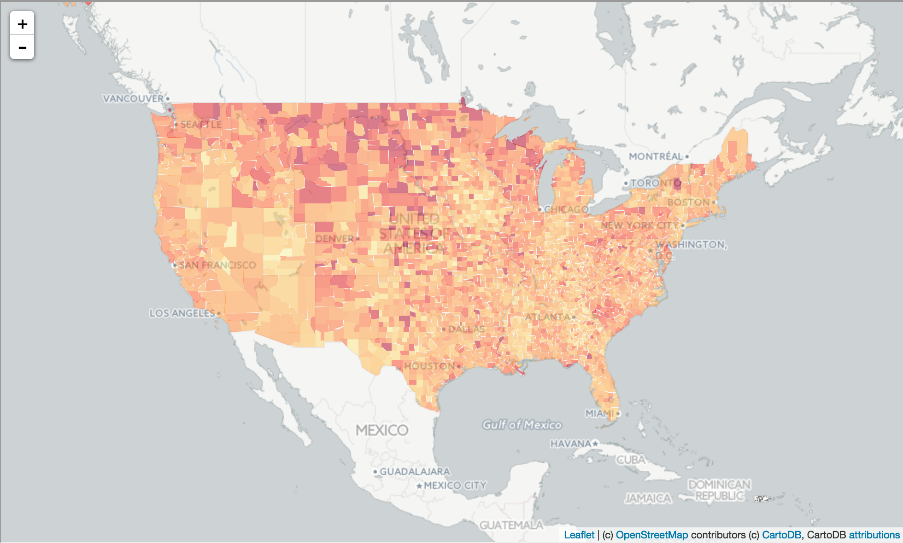
Drunk Accident Percentage per County

Slide 8
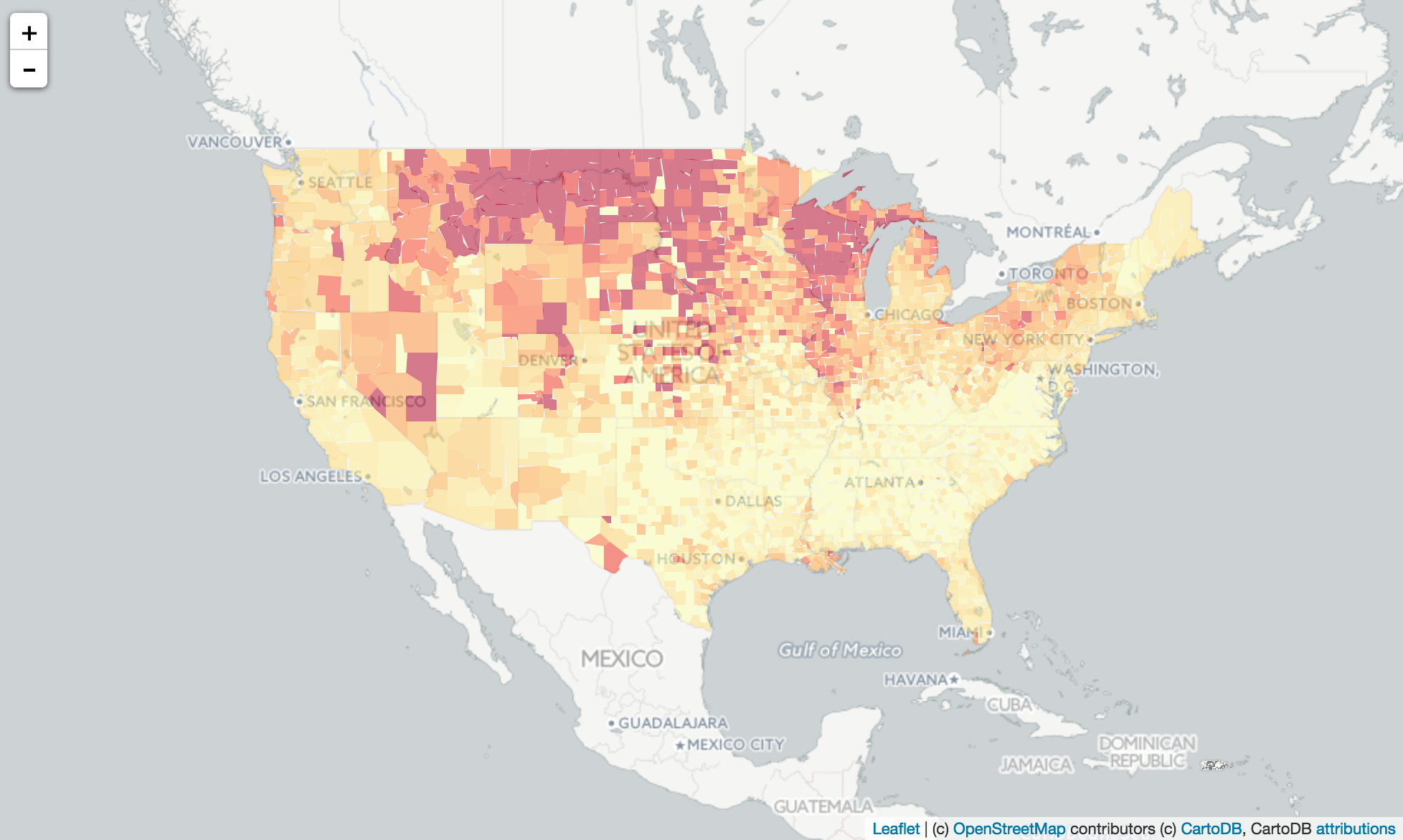
cbp 2010
census.gov

Slide 9
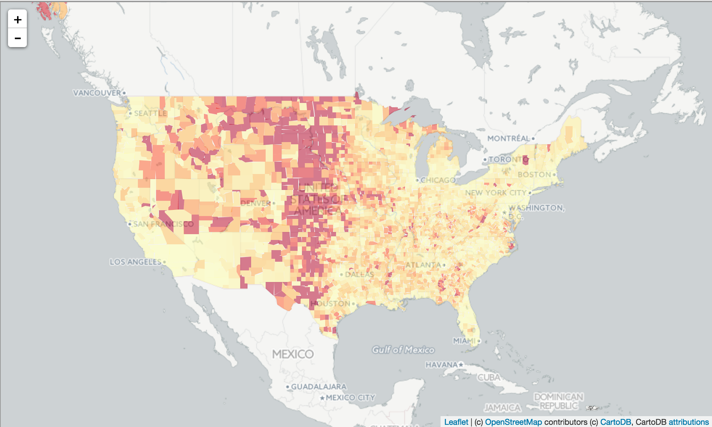
inverse population density

Slide 10
Who

Slide 11
Wisconsin!

Slide 12
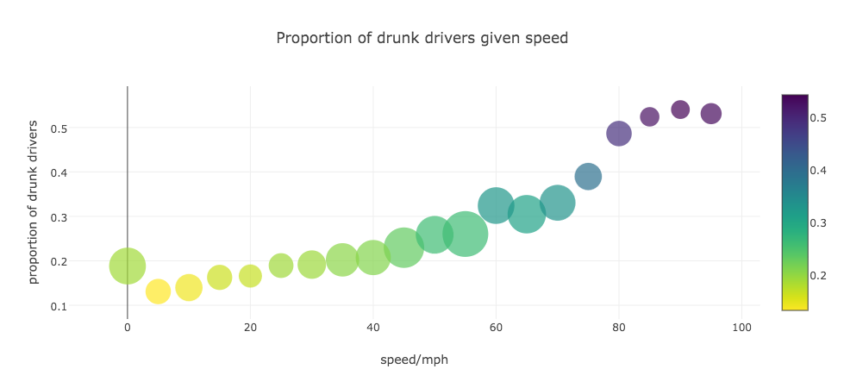
Drunk==Reckless?

Slide 13
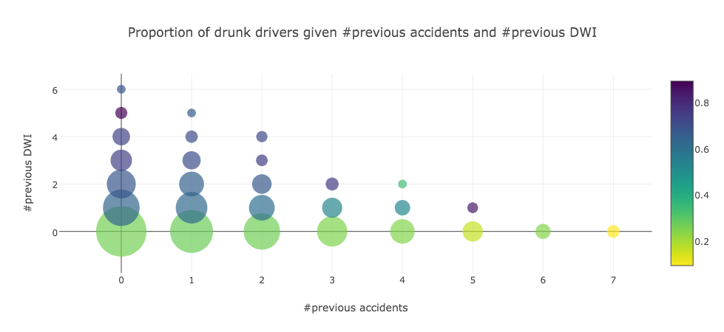
History Tells

Slide 14
The Team
Cyrus Anderson
Chengyu Dai
Cupjin Huang
Wenbo Shen

